Slide 1
Reducing Concussions During Punts Daniel Saltz, Jeffrey Saltz
2019 Kaggle Competition

Slide 2
OUTLINE
1. Key Driver For Concussions on Punts
2. Suggested Rule Changes
3. Projected Reduction in Concussions
4. Impacts to the “Game of Football”

Slide 3
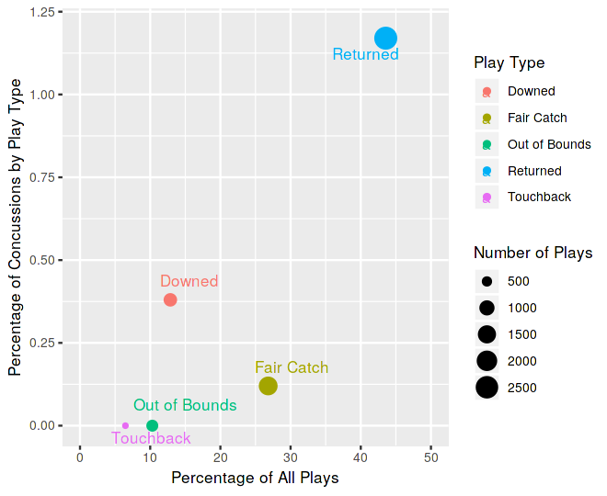
Returned Punts are 8 times more likely to Cause a Concussion than Non Returned Punts
“Non Returned” Punts:
Fair catches
Downed
Punts out of bounds
Touchbacks

Slide 4
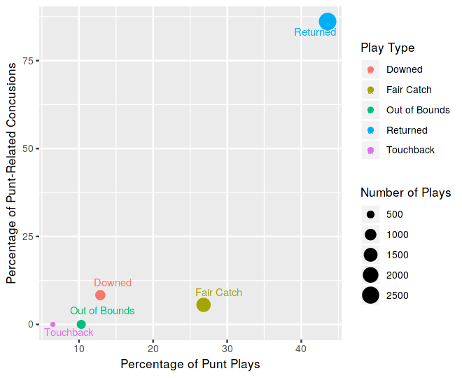
Only 44% of Punts are Returned, But those returns Account for 86% of concussions During Punt Plays
“Non Returned” Punts:
Fair catches
Downed
Punts out of bounds
Touchbacks

Slide 5
Conclusion: To reduce Concussions, punt returns should be minimized
In summary, punt returns:
Are 8 times more likely to cause a concussion than non returned punts
Account for 86% of the concussions that occur during punt plays

Slide 6
Suggested Rule Changes
Fair catches should be incentivized with a 5 yard bonus
Add under Rule 10, Section 2, Article 4
All members of the punting team should be permitted cross the line of scrimmage prior to the punt
The current rules only allow the 2 gunners to cross the line of scrimmage before the punt is kicked
To make this rule change, simply eliminate the "Ineligible Downfield Kick" penalty
This would restore the rules to how they were prior to 1974

Slide 7
Explanation of Suggested Rule Changes
For rule change 1:
Assigning a 5 yard bonus for fair catches will change the incentives for when it makes sense to return a punt
Only punt returns that are expected to gain greater than 5 yards would be considered a “smart decision”
For rule change 2:
In 1974, the NFL implemented a rule change in an attempt to increase excitement on punt plays. They prohibited all members of the punting team except the 2 gunners from crossing the line of scrimmage before the punt was kicked
This rule change increased the average punt return distance by 2 yards, and increased the number of punt returns by 30%.
Reversing this rule to allow all players to run downfield and cover the return man would likely have the opposite effect of the 1974 rule change – average punt return distances would decrease by 2 yards, and fair catches would increase substantially

Slide 8
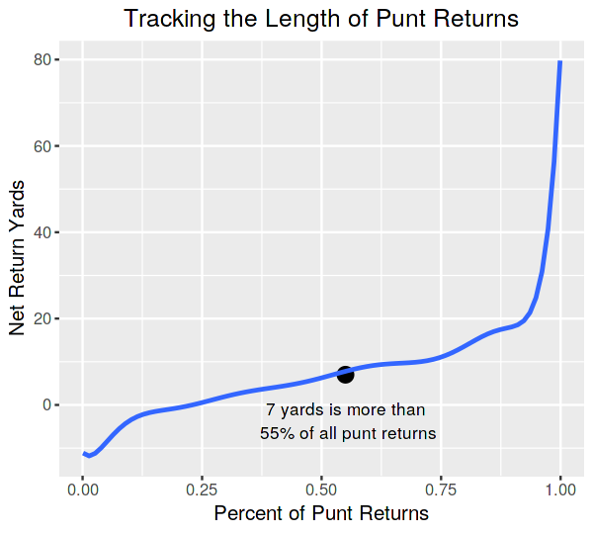
How many fewer punt returns will there be?
The 5 yard fair catch bonus from rule 1 will effectively make punt returns 5 yards worse off than they were in 2016-2017
Better punt return coverage (from rule change 2) will make returning punts more challenging, leading punt returns to drop by an additional 2 yards
Combined, punt returns will by 7 yards worse off
55% of punt returns went for less than 7 yards*
→ Teams will fair catch much more often, since the expected results will be better via a fair catch as compared to a punt return.
→ Hence, we approximate that there will be a reduction of returned punts by 55%.
* This statistic refers to net yardage after factoring in penalties

Slide 9
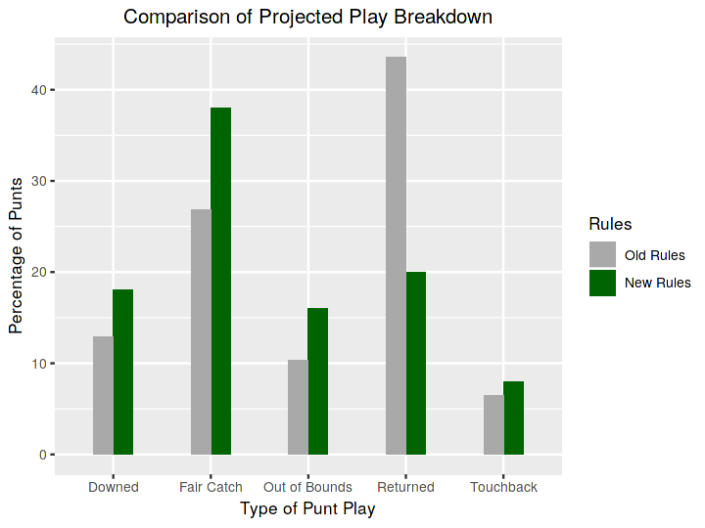
Expected Breakdown of punt plays under new rules
How will punt plays change?
Fair catches → Will increase because of the 5 yard bonus and better punt coverage
Punts out of bounds → Will increase to avoid fair catches, especially near the goal line
Downed punts → Will increase if punters try to “squib” the ball in an attempt to avoid a fair catch
Touchbacks → Will remain the same
Teams will go for it on fourth down more often → This reduces the overall number of punts

Slide 10
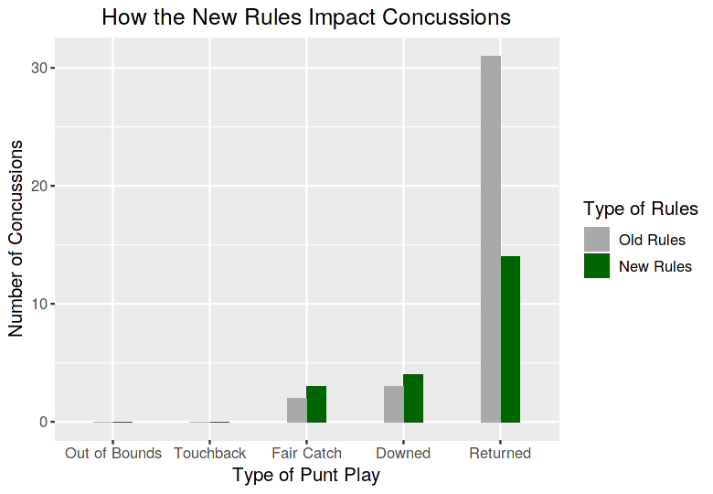
Net Impact: Concussions will be reduced by 41%
Projecting concussions under the new rules:
We held constant the percentage of concussions for each type of punt play
We recalculated the number of concussions that would occur under the new rules, based on the new expected proportion of each type of punt play
Key Impact:
There will be a significant reduction in concussions during punt plays, largely because the number of punt returns reduce dramatically

Slide 11
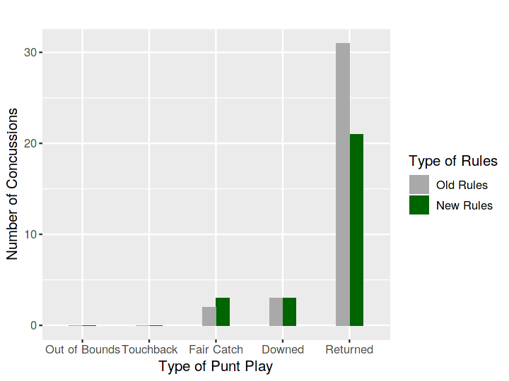
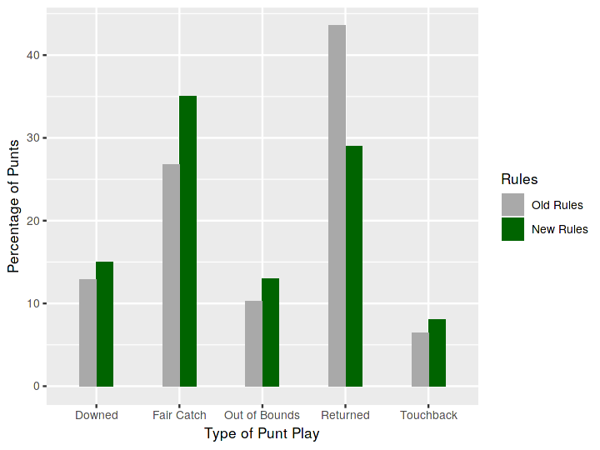
Even if punt returns only decrease by 35%, Concussions would still be drop by 26%
Punt Play Breakdown
Reduced Concussions

Slide 12
What About enforcing single coverage on Gunners?
Single vs Double Coverage:
There a reduction in concussions from having single coverage on gunners (vs double coverage)
Single covered gunners are able to get downfield quicker, forcing punt returners into making fair catches more often.
The increased rate of punt returns (when double covering gunners) is what what causes the large majority of punt-related concussions.
Mandate single coverage on gunners:
There are a few factors that make this rule change less than ideal
First, it is not clear how to prohibit double coverage on gunners.
You can prohibit two defenders from standing across a gunner at the line of scrimmage, but what if one defender stays at the line of scrimmage while another waits 20 yards back? Enforcing such a rule would be difficult and would have to include additional other rule changes for the rule to be possible.
Second, single vs double coverage could be an indicator of: “punt return” vs “punt block” goal of the return team
Third, single vs. double coverage on gunners does not solve the main problem → As shown in the chart below, most punt returns occur when the line of scrimmage of the punt is inside the 35 yard line.

Slide 13
Wont fans miss the excitement of punt returns?
Punt returns won’t be missed:
Punt returns aren’t that interesting anyway
Only 8% of punts net more than 20 yards
Teams will “go for it” more on 4th down:
Which increases drama and excitement
Penalties will decrease:
20% of Returned Punts Have a Penalty¹ (Compared to 8% for Non Returned Punts)
Penalties are frustrating to fans
Penalties lengthen the duration of the game
New punting strategies will be interesting:
Punters may try to squib punts – which would be interesting for the fans
^{1.} These percentages do not include offsetting penalties, declined penalties, or penalties that resulted in a “no play”

Slide 14
In Summary:
86% of punt-related concussions occur during punt returns
The suggested rule changes would effectively make punt returns 7 yards worse off than they were under the previous rules, which would lead to a dramatic decrease in punt returns
Game action will be more exciting because:
Punt returns aren’t that interesting anyway - Only 8% of punts net more than 20 yards
Teams will “go for it” more on 4th down
Penalties will be reduced, which speeds up the pace of the game
The new punting strategy will be interesting
The suggested rule changes would reduce concussions during punts by 41%

